Slide 1
GeoGreenView
TerraBytes Team
NASA International Space Apss Challenge

Slide 2

Introduction
GeoGreenView is an interactive web-based tool designed to analyze and compare the green areas (vegetation) within urban spaces, focusing in our hometown: Puebla, México.
This tool allows users to explore and visualize the distribution of green zones by dividing the city into grids and analyzing satellite images to detect urban vegetation.

Slide 3




How does it work?
What did we utilized?
GeoGreenView operates by using satellite images sourced from Google Maps.
The cities are divided into grid-like sections, and a custom-built vegetation detection algorithm is applied to each grid.
This algorithm processes the images to identify and highlight areas covered by vegetation.

Slide 4
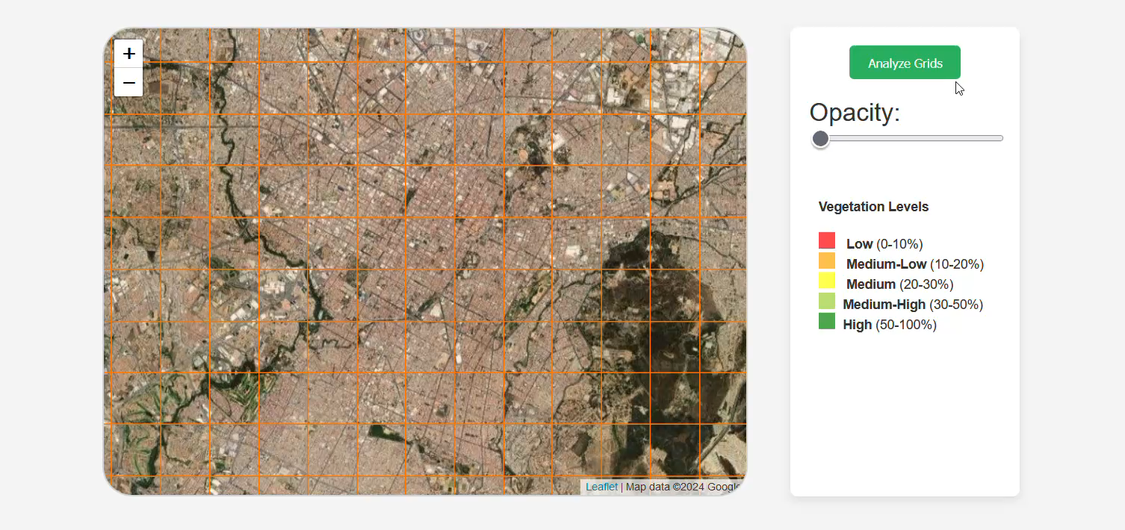
GeoGreenView in action!

Slide 5
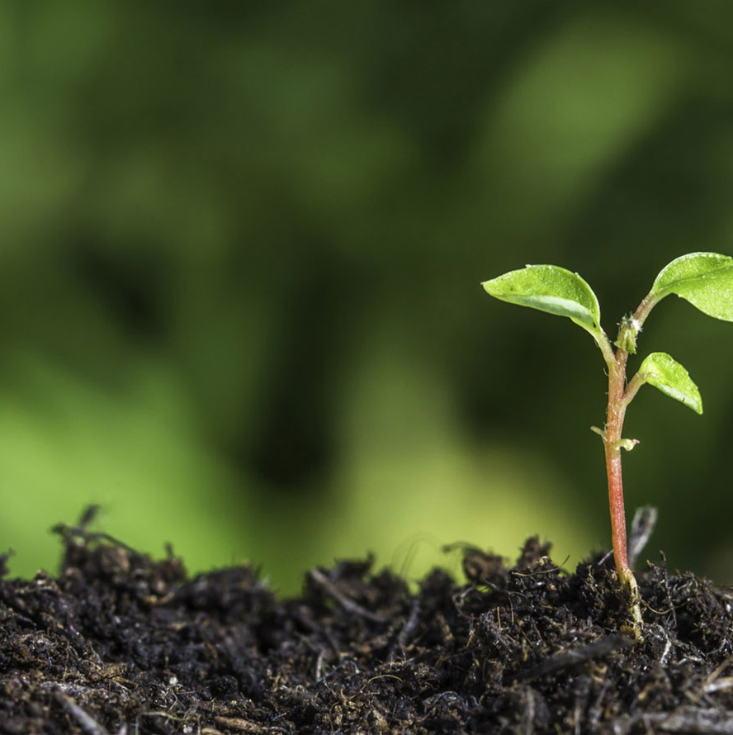
What do we hope to achieve?
GeoGreenView aims to foster an understanding of the critical role of green spaces in urban planning.
It seeks to inform both policymakers and citizens about the disparities in green space availability and the need for greener, more sustainable urban environments.
Through the interactive display of this information, the tool aspires to encourage more proactive approaches to urban development that prioritize the integration of green areas, especially in cities where these spaces are limited.

Slide 6

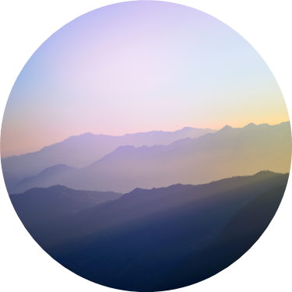


Thank you!
From the TerraBytes team

